Slide 1
Academic Dishonesty By Artificial Intelligence
Bethany Tran
Computer Engineering
Texas A&M University
10/23/24
Notes:
This file presents an assertion-evidence template for making effective slides for scientific presentations. Although much about the layout and typography contrasts sharply with the defaults of PowerPoint, these changes are done so to make the slides more effective at communicating technical information. The design advocated by this template arises from Chapter 4 of The Craft of Scientific Presentations, 2nd edition (Springer, 2013). The homepage for this template exists at the following website:
http://www.assertion-evidence.com
Right now you are viewing the notes pages. To work on the slides, click on “Slide” under “View.” Tip: When creating a new presentation, save this file as the name of your presentation. Warning: You are more than welcome to use this template for your presentation slides. You may not, though, distribute this template for profit or distribute this template without giving credit to the source: http://www.assertion-evidence.com/
This slide is for the title slide of a presentation. Consider inserting an image that helps orient the audience to the title. You should not leave this slide until the audience feel comfortable with the title. Spending more time with this slide is good because a common mistake in presentations is to leave the title slide too soon. Because of this mistake, many in the audience do not have the chance to comprehend the key details of the title. See pages 172-184 in The Craft of Scientific Presentations, 2nd ed. (CSP).

Slide 2
Different solutions to preventing academic dishonesty by AI
Increased surveillance of students
Psychological methods
AI detection software
Notes:
Mapping slide for the presentation (note that a background slide or a slide justifying the importance might precede this slide). A common mistake with mapping slides is to give the audience simply an unmemorable bulleted list of topics (including the names “Introduction” and “Conclusion” and “Questions”). Such a list is quickly forgotten after the slide is removed.
On a mapping slide, take the opportunity to show a key image or perhaps a representative image for each major section of the presentation. In the second case, each image would be repeated on the first visual of the corresponding section and would remind the audience that they have arrived to a major section of the presentation’s middle.
In regards to the names “Introduction” and “Conclusion,” every talk has those sections, and the names are ignored by audiences. So why state them? Also, for the divisions that you do have, find a logical and parallel grouping. Note that groups of two’s, three’s, and four’s are much easier to remember and are not so nearly intimidating as groups of five’s, six’s, and seven’s. See the discussion of mapping slides in The Craft of Scientific Presentations, 2nd ed. (pages 177-181).

Slide 3
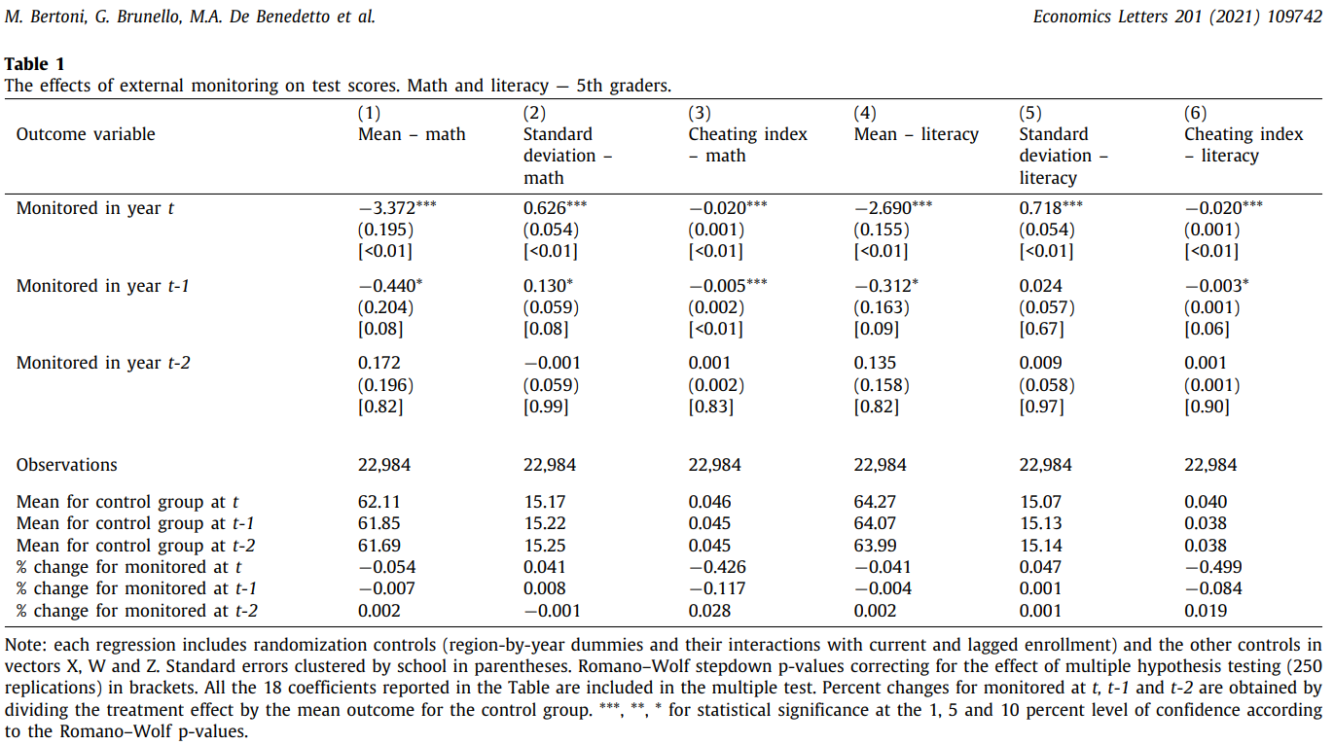
The first solution is increased surveillance of students when doing assignments
(Bertoni et al., 2021)
Notes:
Body slide from the first section of the presentation’s middle. Consider having the first-topic image from the mapping slide repeated here. Use the headline (no more than two lines) to make an assertion about this topic. In the body of the slide, support that headline with images and with words, if necessary. See Chapter 4 of The Craft of Scientific Presentations, 2nd ed.
This slide shows one orientation for the image and text in the body of the slide. Other orientations appear in this template. Choose the one that best supports your headline assertion.
Some institutions will insist that you place an institutional logo on each slide. Other institutions recommend a logo on the first slide and the last. If you do place a logo on each slide, make sure that logo is at the bottom of the slide rather than the top. Placing the logo at the top (the place on a slide that receives the most emphasis) shifts the emphasis away from the work.
Machine learning works by taking in a bunch of data and putting it through an algorithm (which interprets data) to create an output
more data = more accuracy
In investing, the key is to recognize patterns from history to make predictions about the future in which artificial intelligence can help do that
linear regression
used to predict the value of a variable based on the value of another variable.

Slide 4
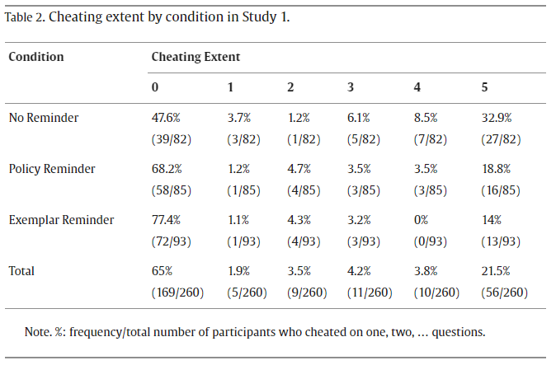
The second solution is to discourage cheating using psychological methods.
(Zhao et a, 2023)
Notes:
Body slide from the third section of the presentation’s middle. For the first body slide of this third section, consider repeating the corresponding image from the mapping slide. Use the headline to say state an assertion about this topic. In the body of the slide, support that headline with images and with needed callouts. See Chapter 4 of The Craft of Scientific Presentations, 2nd ed..
This slide shows one orientation for the image and text in the body of the slide. Other orientations appear in this template. Choose the orientation that best supports your headline assertion.

Slide 5
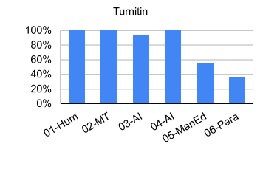
The third and best solution is to fight AI with AI using detection software
(Weber-Wulff et al., 2023)
Notes:
Body slide from the second section of the presentation’s middle. For the first body slide of this second section, consider repeating the corresponding image (or equation) from the mapping slide. Use the headline to make an assertion about this topic. In the body of the slide, support that headline assertion with images and needed callouts. See Chapter 4 of The Craft of Scientific Presentations, 2nd ed.
This slide shows one orientation for the image and text in the body of the slide. Other orientations appear in this template. Choose the orientation that best supports your headline assertion.

Slide 6
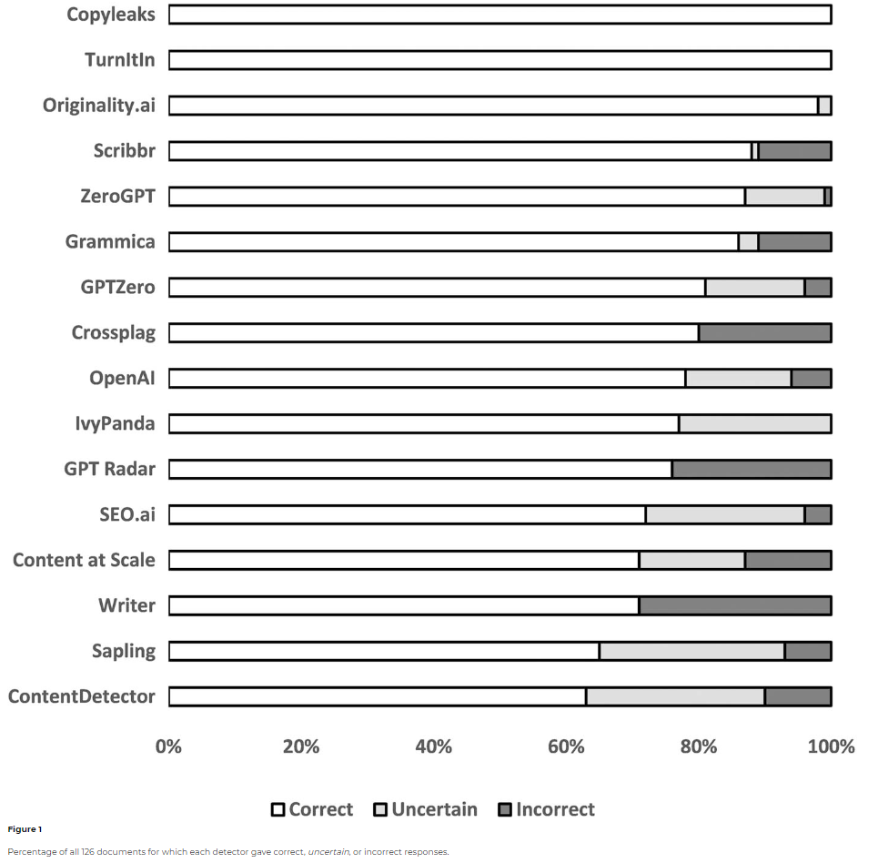
The third and best solution is to fight AI with AI using detection software
(Walters, 2023)
Notes:
Body slide from the second section of the presentation’s middle. For the first body slide of this second section, consider repeating the corresponding image (or equation) from the mapping slide. Use the headline to make an assertion about this topic. In the body of the slide, support that headline assertion with images and needed callouts. See Chapter 4 of The Craft of Scientific Presentations, 2nd ed.
This slide shows one orientation for the image and text in the body of the slide. Other orientations appear in this template. Choose the orientation that best supports your headline assertion.

Slide 7
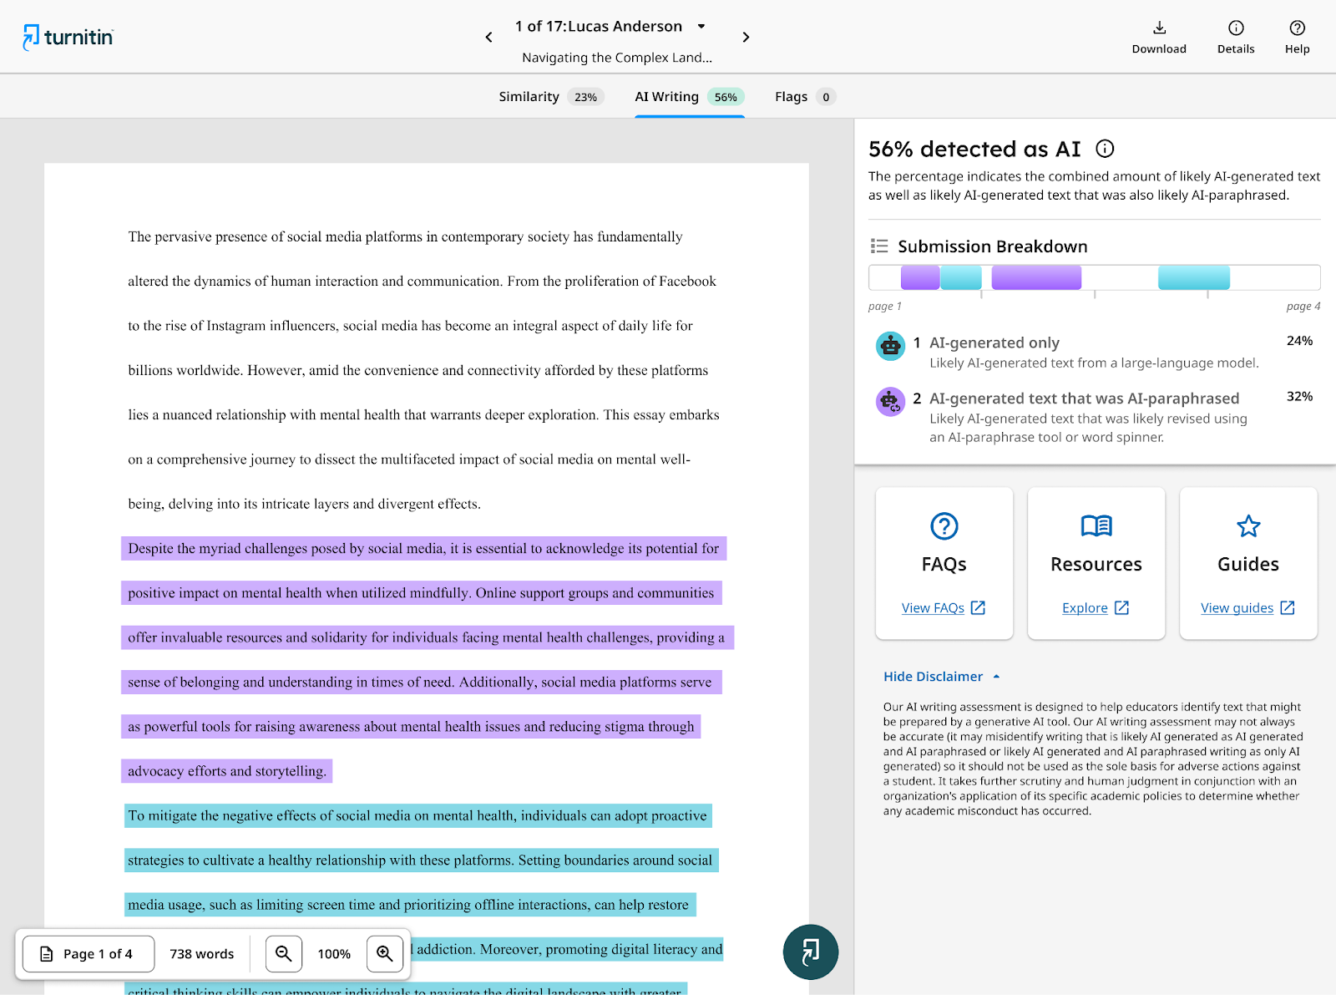
The third and best solution is to fight AI with AI using detection software
Turnitin
Notes:
Body slide from the second section of the presentation’s middle. For the first body slide of this second section, consider repeating the corresponding image (or equation) from the mapping slide. Use the headline to make an assertion about this topic. In the body of the slide, support that headline assertion with images and needed callouts. See Chapter 4 of The Craft of Scientific Presentations, 2nd ed.
This slide shows one orientation for the image and text in the body of the slide. Other orientations appear in this template. Choose the orientation that best supports your headline assertion.

Slide 8
AI detection software is the best solution to prevent AI cheating
The most efficient and automated solution
Ways to avoid false positives
Questions?
Notes:
Conclusion slide. Use the headline (no more than two lines) to state your most important conclusion. Begin the headline with In summary or In conclusion to ensure that the audience knows they have come to the presentation’s end. Support that headline with an image and parallel points.
This slide should be your last slide. Audiences lose patience when they believe that they have come to the end, but other slides follow.
Notice that the word Questions appears at the bottom of this slide. That strategy is much more effective than burning a slide with just the word Questions. This slide allows the audience to look at the most important slide of the presentation during the question period. See The Craft of Scientific Presentations, 2nd ed., pages 182-183.

