Slide 1
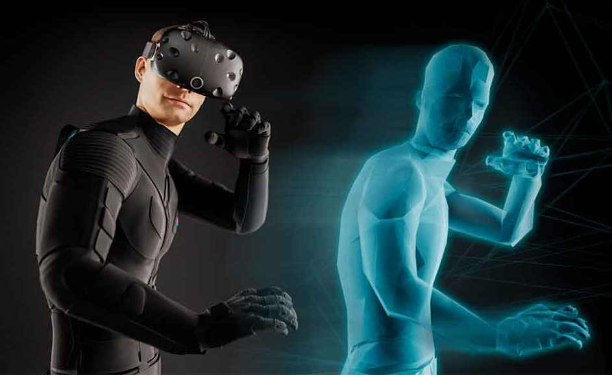
The Umbrella Haptic VR: A Glimpse into the Future of Virtual Reality
Ryland Chu
Gaston Gonzalez
Andrew-Joseph Nicolas
Bethany Tran
Victor Valdez
Umbrella Corporation
11/15/24
Notes:
This file presents an assertion-evidence template for making effective slides for scientific presentations. Although much about the layout and typography contrasts sharply with the defaults of PowerPoint, these changes are done so to make the slides more effective at communicating technical information. The design advocated by this template arises from Chapter 4 of The Craft of Scientific Presentations, 2nd edition (Springer, 2013). The homepage for this template exists at the following website:
http://www.assertion-evidence.com
Right now you are viewing the notes pages. To work on the slides, click on “Slide” under “View.” Tip: When creating a new presentation, save this file as the name of your presentation. Warning: You are more than welcome to use this template for your presentation slides. You may not, though, distribute this template for profit or distribute this template without giving credit to the source: http://www.assertion-evidence.com/
This slide is for the title slide of a presentation. Consider inserting an image that helps orient the audience to the title. You should not leave this slide until the audience feel comfortable with the title. Spending more time with this slide is good because a common mistake in presentations is to leave the title slide too soon. Because of this mistake, many in the audience do not have the chance to comprehend the key details of the title. See pages 172-184 in The Craft of Scientific Presentations, 2nd ed. (CSP).

Slide 2
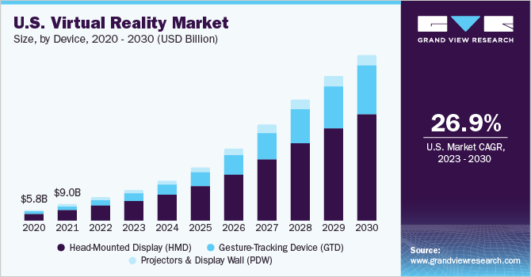
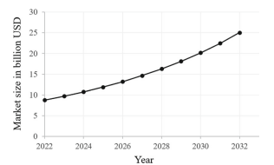
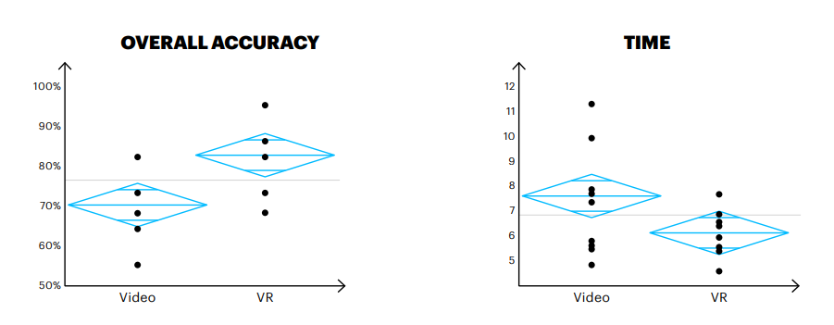
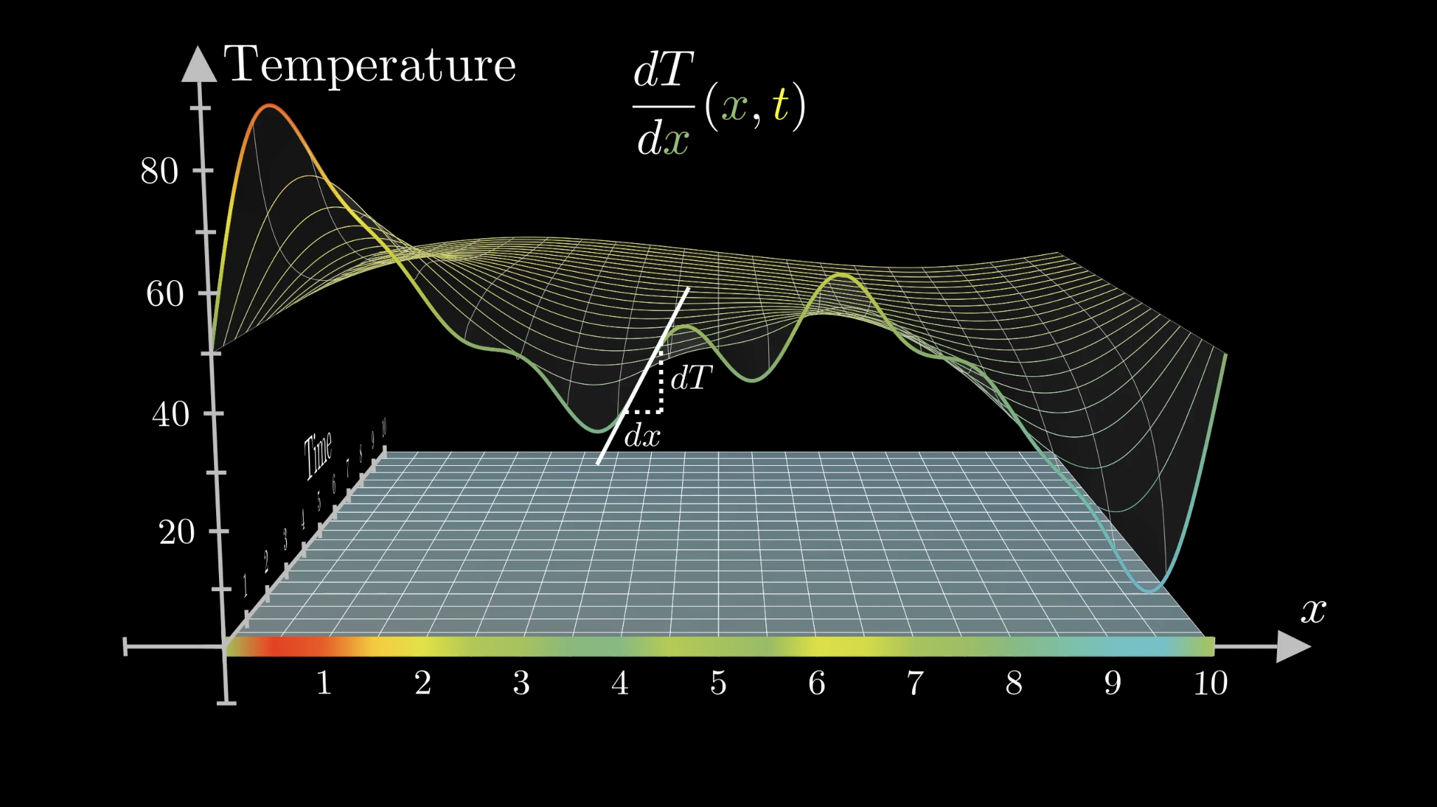
The future of haptic suit technology will alter the future of entertainment, education, and professional training.
VR technology is a highly marketable and growing industry worth billions of dollars.
VR’s need to be introduced in medicine, military, and entertainment fields.
Why it is necessary to fund development of a haptic suit.
A haptic bodysuit would increase user satisfaction and the professional use of VR.
VR will allow for immersive learning experiences in various areas.
Notes:
Mapping slide for the presentation (note that a background slide or a slide justifying the importance might precede this slide). A common mistake with mapping slides is to give the audience simply an unmemorable bulleted list of topics (including the names “Introduction” and “Conclusion” and “Questions”). Such a list is quickly forgotten after the slide is removed.
On a mapping slide, take the opportunity to show a key image or perhaps a representative image for each major section of the presentation. In the second case, each image would be repeated on the first visual of the corresponding section and would remind the audience that they have arrived to a major section of the presentation’s middle.
In regards to the names “Introduction” and “Conclusion,” every talk has those sections, and the names are ignored by audiences. So why state them? Also, for the divisions that you do have, find a logical and parallel grouping. Note that groups of two’s, three’s, and four’s are much easier to remember and are not so nearly intimidating as groups of five’s, six’s, and seven’s. See the discussion of mapping slides in The Craft of Scientific Presentations, 2nd ed. (pages 177-181).

Slide 3
VR technology is a highly marketable and growing industry worth billions of dollars
Gupta et al. (2024)

Slide 4
What are we seeking to solve?
Notes:
Blank slide for drafting mapping slide

Slide 5
Popularity of VR in general has grown significantly in terms of overall
Notes:
intro popularity of VR in general
explain study
show results for overall
show results of gesture tracking device
conclude popularity on VR in us market

Slide 6
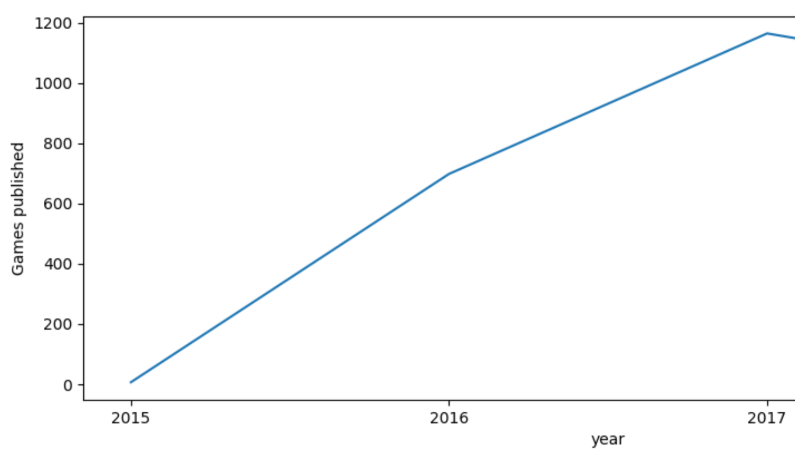
Popularity of VR in general has grown significantly in terms of recreational use
Notes:
introduce vr in gaming
explain study
explain chart
conclude popularity on vr in video games

Slide 7
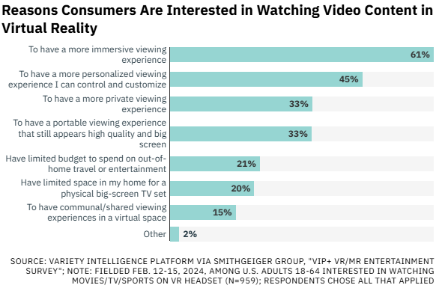
Popularity of VR in general has grown significantly in terms of recreational use
Notes:
intro reasons people like VR for entertainment
explain study
show results for top 3
conclude why people like VR in entertainment

Slide 8
Virtual reality has a market in the medical field
Notes:
intro medical field
explain study
explain each type of surgery
conclude why immersive vr is important

Slide 9
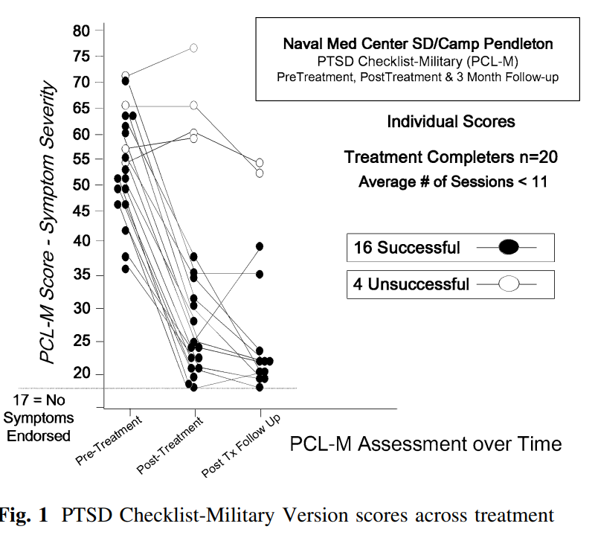
Virtual reality has a market in the military field
Notes:
intro military field PTSD symptoms
explain study
conclude why immersive VR is important for military and other mental health treatment

Slide 10
The Product
Notes:
Blank slide for drafting mapping slide

Slide 11
Haptic suits are necessary in unlocking the full potential and market size of VR
Notes:
Body slide from the first section of the presentation’s middle. Consider having the first-topic image from the mapping slide repeated here. Use the headline (no more than two lines) to make an assertion about this topic. In the body of the slide, support that headline with images and with words, if necessary. See Chapter 4 of The Craft of Scientific Presentations, 2nd ed.
This slide shows one orientation for the image and text in the body of the slide. Other orientations appear in this template. Choose the one that best supports your headline assertion.
Some institutions will insist that you place an institutional logo on each slide. Other institutions recommend a logo on the first slide and the last. If you do place a logo on each slide, make sure that logo is at the bottom of the slide rather than the top. Placing the logo at the top (the place on a slide that receives the most emphasis) shifts the emphasis away from the work.

Slide 12
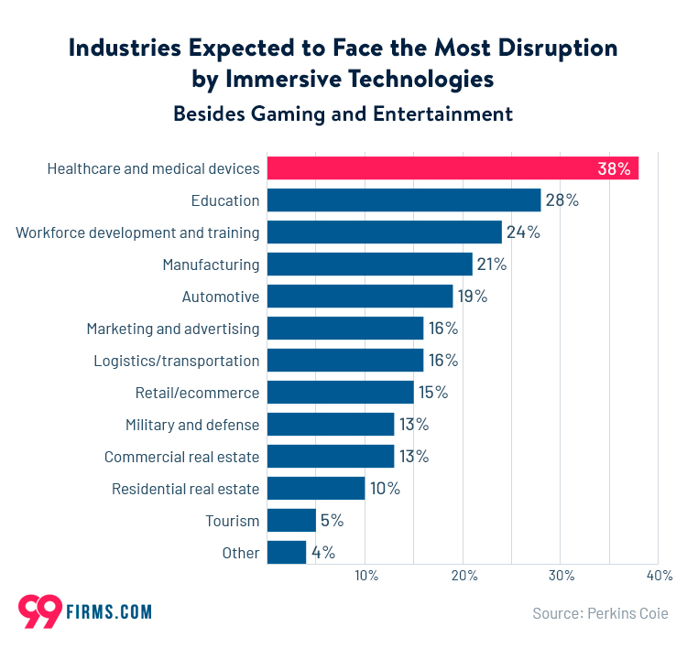
Applications for haptic suit technology are increasing.
Notes:
Blank slide for drafting a body slide.

Slide 13
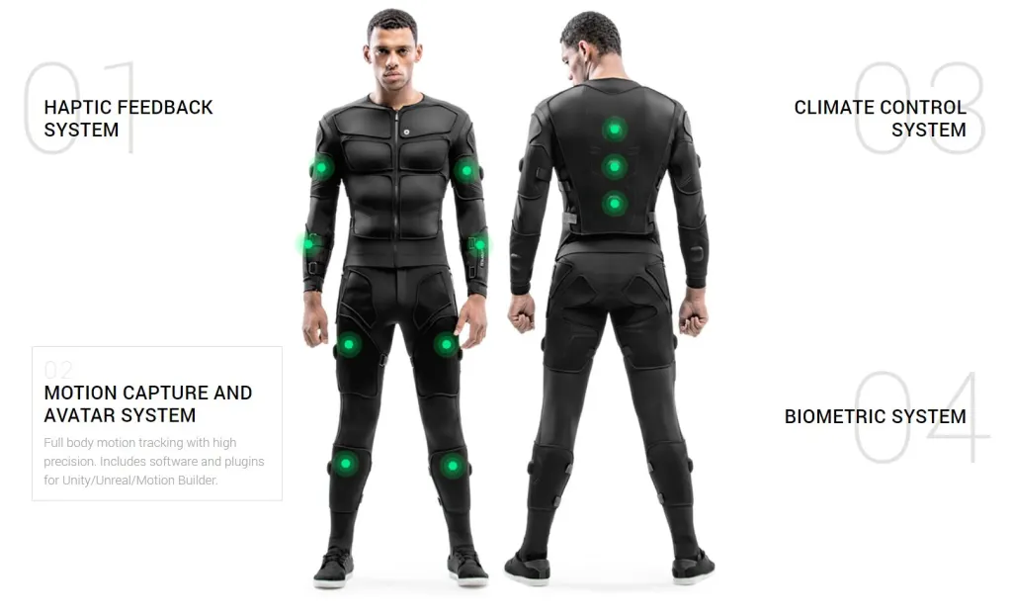
Competition within the haptic suit industry is rising.
Notes:
Body slide from the second section of the presentation’s middle. For the first body slide of this second section, consider repeating the corresponding image (or equation) from the mapping slide. Use the headline to make an assertion about this topic. In the body of the slide, support that headline assertion with images and needed callouts. See Chapter 4 of The Craft of Scientific Presentations, 2nd ed.
This slide shows one orientation for the image and text in the body of the slide. Other orientations appear in this template. Choose the orientation that best supports your headline assertion.

Slide 14
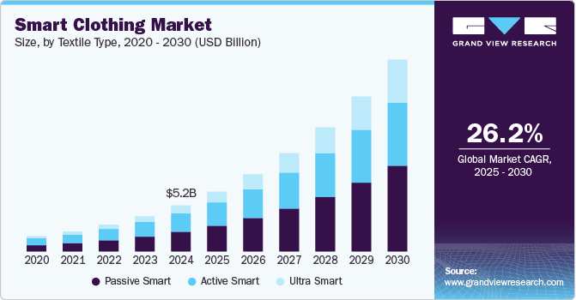
By combining existing haptic suit technology with smart fitting technology our suit will be the best.
Notes:
Blank slide for drafting a body slide.

Slide 15
The Future

Slide 16
Embracing VR in education allows for better immersion and engagement in complex subjects.
3Blue1Brown, 2019

Slide 17
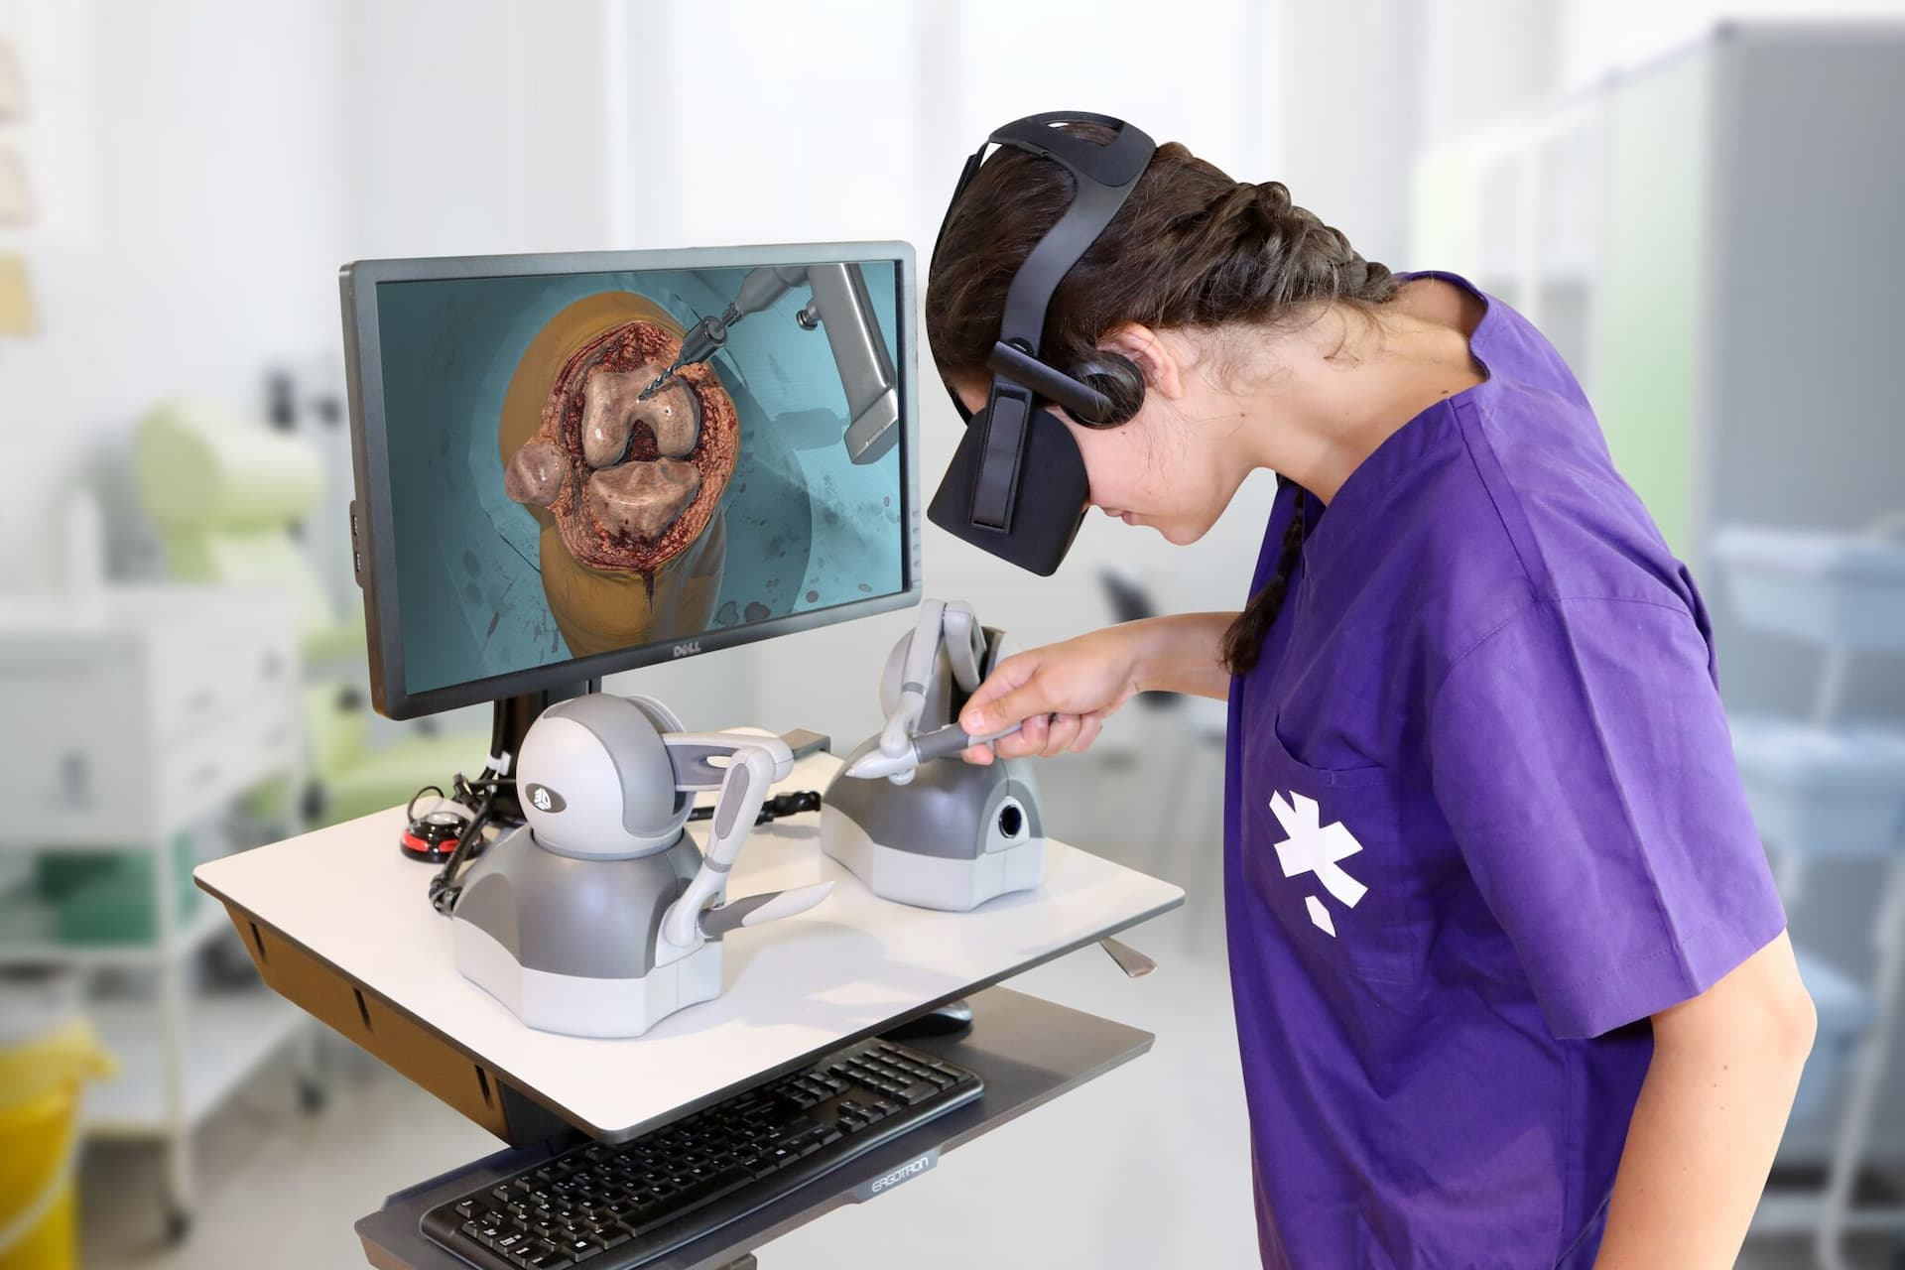
Embracing VR in education allows for better immersion and engagement in complex subjects.
Onix Systems, 2024

Slide 18
Embracing VR in education allows for better immersion and engagement in complex subjects.
The Familiar Strange, 2022

Slide 19
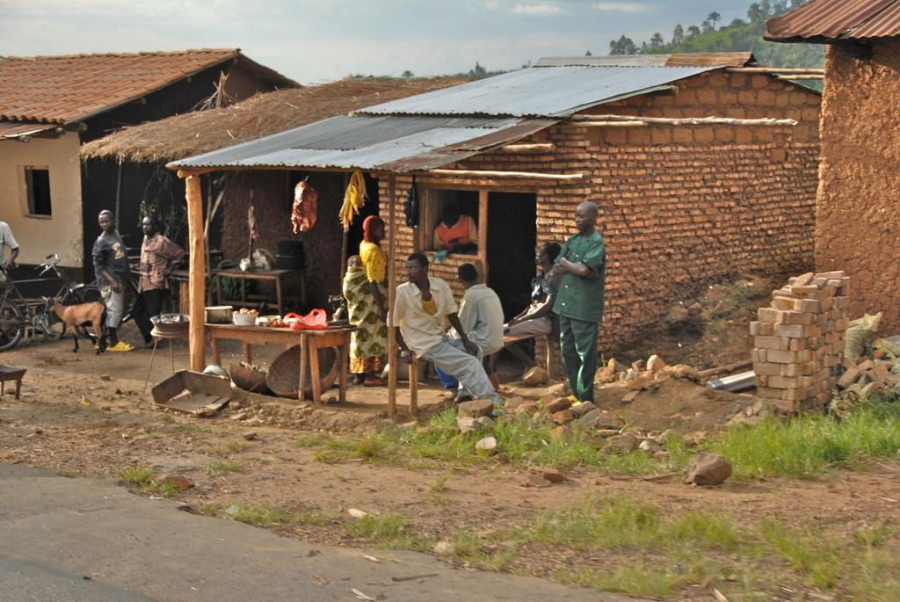
Embracing VR in education allows for better immersion and engagement in complex subjects.
The Borgen Project, 2016

Slide 20
Why should you invest?

Slide 21
Investing in the Development of Our VR Haptic Suit: A Key to Reducing Costs and Dominating the Emerging Market
Haptic Technology Adoption and Future Trends
Kuhail et al. (2024)
Notes:
Body slide from the third section of the presentation’s middle. For the first body slide of this third section, consider repeating the corresponding image from the mapping slide. Use the headline to say state an assertion about this topic. In the body of the slide, support that headline with images and with needed callouts. See Chapter 4 of The Craft of Scientific Presentations, 2nd ed..
This slide shows one orientation for the image and text in the body of the slide. Other orientations appear in this template. Choose the orientation that best supports your headline assertion.

Slide 22
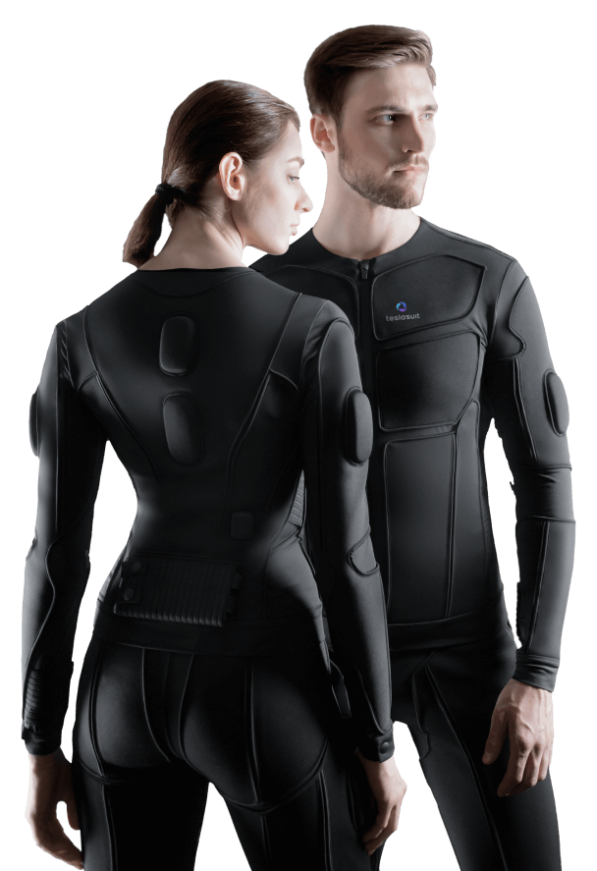
Our Product is the Future of VR Haptic Suits
We Are Expanding Immersive Experiences
VR Haptic Suits Have High Market Growth Potential
Questions?
Notes:
Conclusion slide. Use the headline (no more than two lines) to state your most important conclusion. Begin the headline with In summary or In conclusion to ensure that the audience knows they have come to the presentation’s end. Support that headline with an image and parallel points.
This slide should be your last slide. Audiences lose patience when they believe that they have come to the end, but other slides follow.
Notice that the word Questions appears at the bottom of this slide. That strategy is much more effective than burning a slide with just the word Questions. This slide allows the audience to look at the most important slide of the presentation during the question period. See The Craft of Scientific Presentations, 2nd ed., pages 182-183.

